Slide 1
GRADE 7 ACCELERATED · UNIT 2 · LESSON 2
Square Values and Square Roots
MA.8.AR.2.3
I can evaluate a square root and find every real solution of x² = p.
Yesterday you found sides of squares.
Today that gets a symbol — and the symbol is fussy.
Grade 7 Accelerated · Unit 2 · Lesson 2 — Square Values and Square Roots
1

Slide 2
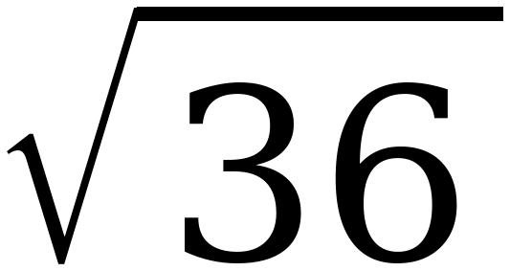
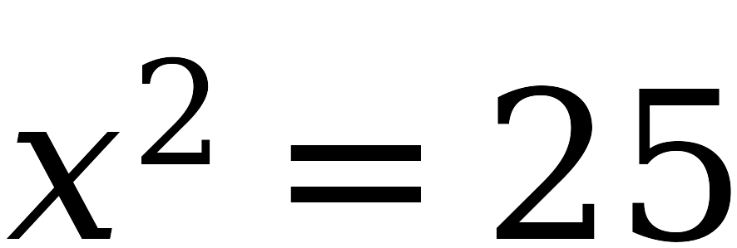
Warm-Up
On your own. Four minutes.
Same and different
What is the same about these two, and what is different?
Grade 7 Accelerated · Unit 2 · Lesson 2 — Square Values and Square Roots
2

Slide 3
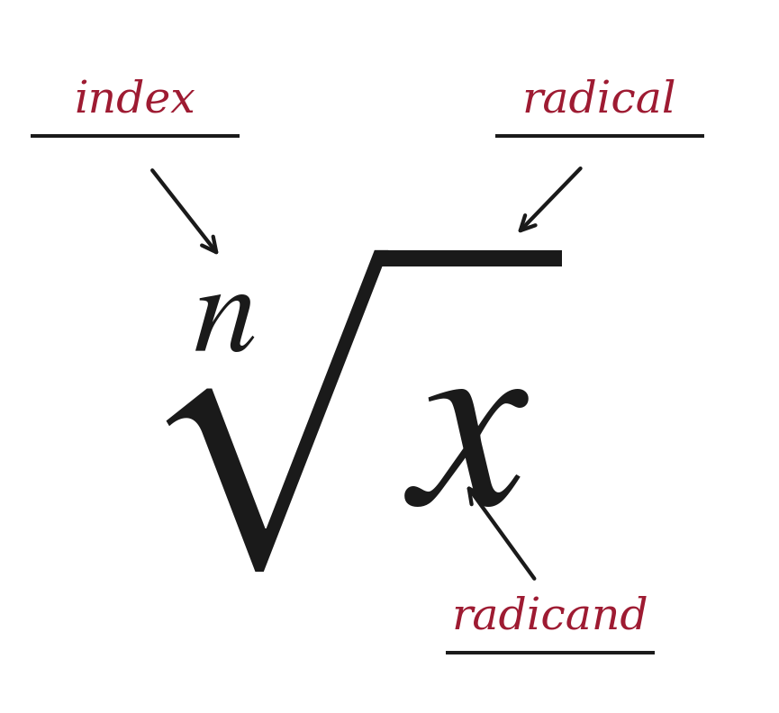
Notes
I. The parts of a radical
A.
radical — the symbol √ that asks for a root
B.
radicand — the number underneath the radical
C.
index — the small number in the notch, saying which root to take
Grade 7 Accelerated · Unit 2 · Lesson 2 — Square Values and Square Roots
3

Slide 4
Notes
II. The symbol and the equation ask different questions
√25 asks for ONE number
x² = 25 asks for EVERY value
the positive square root
both solutions
√25 = 5
x = ±√25 = ±5
Grade 7 Accelerated · Unit 2 · Lesson 2 — Square Values and Square Roots
4

Slide 5
Notes
III. The sign lives outside the symbol
A.
The radical symbol never means two numbers. You write the ± yourself.
B.
√25 = 5. −√25 = −5. ±√25 = ±5.
C.
Three different expressions, and each one names exactly what it says.
Grade 7 Accelerated · Unit 2 · Lesson 2 — Square Values and Square Roots
5

Slide 6
Notes
IV. Solving x² = p — three cases
If p is …
How many solutions
Example
POSITIVE
two, x = ±√p
x² = 49 gives x = ±7
ZERO
one, x = 0
x² = 0 gives x = 0
NEGATIVE
none that are real
x² = −49 has no real solution
Grade 7 Accelerated · Unit 2 · Lesson 2 — Square Values and Square Roots
6

Slide 7
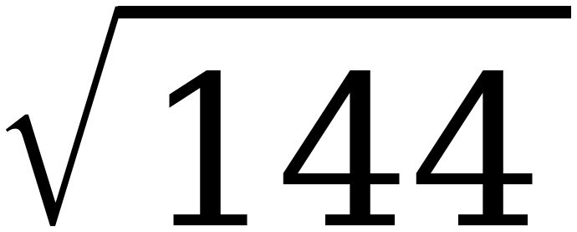
Example 1
Two questions. Same number underneath.
x² = 144
Which one has two answers? Answer out loud.
Grade 7 Accelerated · Unit 2 · Lesson 2 — Square Values and Square Roots
7

Slide 8
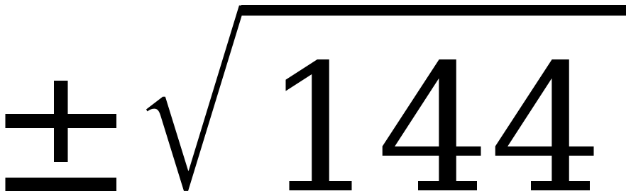
Example 1
Both, worked.
= 12
because 12 × 12 = 144
x² = 144 so x =
= ±12
Grade 7 Accelerated · Unit 2 · Lesson 2 — Square Values and Square Roots
8

Slide 9
Example 1
Check both.
12 × 12 = 144 ✓
(−12) × (−12) = 144 ✓
Grade 7 Accelerated · Unit 2 · Lesson 2 — Square Values and Square Roots
9

Slide 10
Example 2
Xavier's paper. Both answers are on it.
Find the solutions of b² = 25.
What is the value of √25 ?
b = 5 and b = −5
5
One of these is wrong. Which?
Grade 7 Accelerated · Unit 2 · Lesson 2 — Square Values and Square Roots
10

Slide 11
Example 2
Neither.
Both of Xavier's answers are correct.
Why do they look different?
Grade 7 Accelerated · Unit 2 · Lesson 2 — Square Values and Square Roots
11

Slide 12
Example 2
Because they are different questions.
A.
The equation asks which numbers work. Two of them do.
B.
The radical asks for one particular number — the positive one.
C.
The 25 is the same. The question around it is not.
Grade 7 Accelerated · Unit 2 · Lesson 2 — Square Values and Square Roots
12

Slide 13
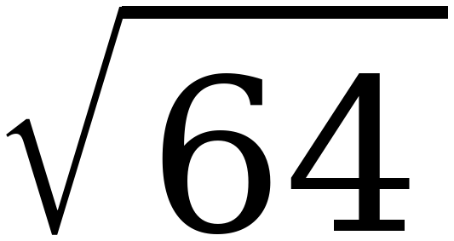
Whiteboards · Question 1 of 9
Boards up on three.
Answer it.
A number, or a sentence. Read which it is asking for.
Grade 7 Accelerated · Unit 2 · Lesson 2 — Square Values and Square Roots
13

Slide 14
Whiteboards · Question 1 of 9
Answer.
the symbol asks for one number
Answer: 8
Grade 7 Accelerated · Unit 2 · Lesson 2 — Square Values and Square Roots
14

Slide 15
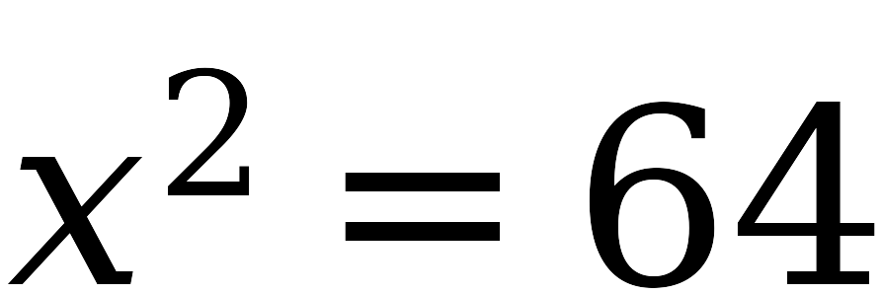
Whiteboards · Question 2 of 9
Boards up on three.
Answer it.
A number, or a sentence. Read which it is asking for.
Grade 7 Accelerated · Unit 2 · Lesson 2 — Square Values and Square Roots
15

Slide 16
Whiteboards · Question 2 of 9
Answer.
which values of x work?
Answer: x = ±8
Grade 7 Accelerated · Unit 2 · Lesson 2 — Square Values and Square Roots
16

Slide 17
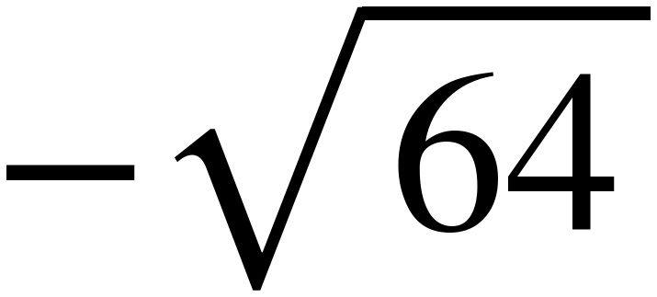
Whiteboards · Question 3 of 9
Boards up on three.
Answer it.
A number, or a sentence. Read which it is asking for.
Grade 7 Accelerated · Unit 2 · Lesson 2 — Square Values and Square Roots
17

Slide 18
Whiteboards · Question 3 of 9
Answer.
the minus sits outside the radical
Answer: −8
Grade 7 Accelerated · Unit 2 · Lesson 2 — Square Values and Square Roots
18

Slide 19
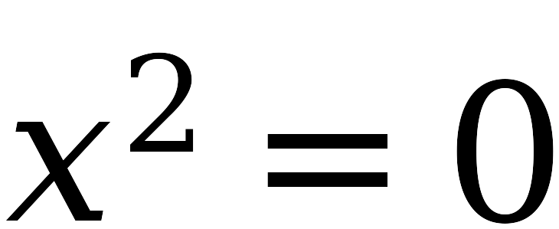
Whiteboards · Question 4 of 9
Boards up on three.
Answer it.
A number, or a sentence. Read which it is asking for.
Grade 7 Accelerated · Unit 2 · Lesson 2 — Square Values and Square Roots
19

Slide 20
Whiteboards · Question 4 of 9
Answer.
0 × 0 = 0, and nothing else does
Answer: x = 0
Grade 7 Accelerated · Unit 2 · Lesson 2 — Square Values and Square Roots
20

Slide 21
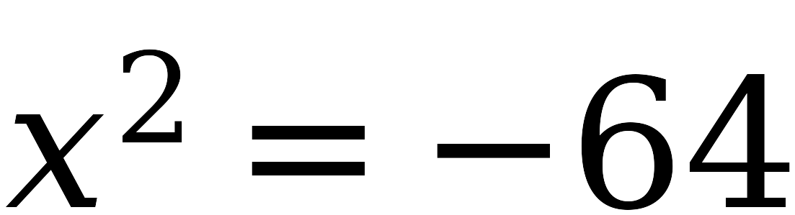
Whiteboards · Question 5 of 9
Boards up on three.
Answer it.
A number, or a sentence. Read which it is asking for.
Grade 7 Accelerated · Unit 2 · Lesson 2 — Square Values and Square Roots
21

Slide 22
Whiteboards · Question 5 of 9
Answer.
nothing real squares to a negative
Answer: no real solution
Grade 7 Accelerated · Unit 2 · Lesson 2 — Square Values and Square Roots
22

Slide 23
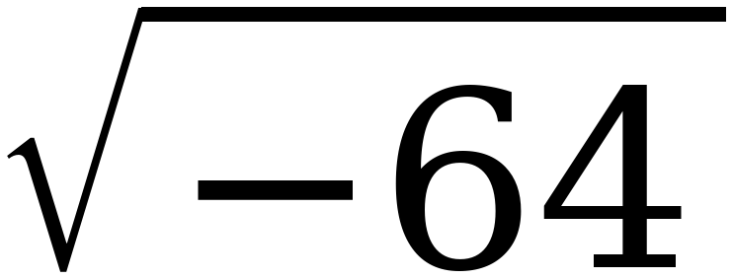
Whiteboards · Question 6 of 9
Boards up on three.
Answer it.
A number, or a sentence. Read which it is asking for.
Grade 7 Accelerated · Unit 2 · Lesson 2 — Square Values and Square Roots
23

Slide 24
Whiteboards · Question 6 of 9
Answer.
same refusal, asked with the symbol
Answer: no real value
Grade 7 Accelerated · Unit 2 · Lesson 2 — Square Values and Square Roots
24

Slide 25
Whiteboards · Question 7 of 9
Boards up on three.
Answer it.
A number, or a sentence. Read which it is asking for.
Grade 7 Accelerated · Unit 2 · Lesson 2 — Square Values and Square Roots
25

Slide 26
Whiteboards · Question 7 of 9
Answer.
5 × 5 = 25 and (−5) × (−5) = 25
Answer: x = ±5
Grade 7 Accelerated · Unit 2 · Lesson 2 — Square Values and Square Roots
26

Slide 27
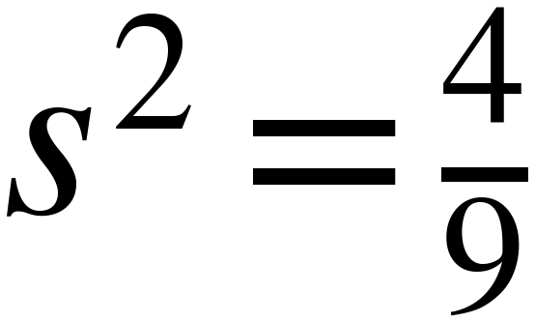
Whiteboards · Question 8 of 9
Boards up on three.
Answer it.
A number, or a sentence. Read which it is asking for.
Grade 7 Accelerated · Unit 2 · Lesson 2 — Square Values and Square Roots
27

Slide 28
Whiteboards · Question 8 of 9
Answer.
(2/3)² = 4/9 and (−2/3)² = 4/9
Answer: s = ±2/3
Grade 7 Accelerated · Unit 2 · Lesson 2 — Square Values and Square Roots
28

Slide 29
Whiteboards · Question 9 of 9
Take your time. Boards up when you have written it.
Jordan says √64 = ±8, because 8 and −8 both square to 64. Is he right?
Write your answer in sentences.
This one is written work. Say which part of what he said is true.
Grade 7 Accelerated · Unit 2 · Lesson 2 — Square Values and Square Roots
29

Slide 30
Whiteboards · Question 9 of 9
Answer.
Jordan says √64 = ±8, because 8 and −8 both square to 64. Is he right?
8² = 64 and (−8)² = 64 — both are true
Answer: No — √64 = 8
Grade 7 Accelerated · Unit 2 · Lesson 2 — Square Values and Square Roots
30

Slide 31
IXL
Last five minutes.
1.
Open IXL and start today's skills.
2.
Work on paper where the question needs work. The answer box does not show it.
3.
Whatever you do not finish is tonight's practice.
4.
The skills for today are posted in Google Classroom.
Grade 7 Accelerated · Unit 2 · Lesson 2 — Square Values and Square Roots
31

